Slide 1
Prevalence of white spot lesions during orthodontic treatment with fixed appliances
Eser Tufekcia; Julian S. Dixonb; J.C. Gunsolleyc; Steven J. Lindauerd
Angle Orthodontist,
Vol 81, No 2, 2011
Anisha Valli,
Department of Orthodontics
First Year
Notes:
Hello everyone,
Today, we're diving into the world of White Lesions on enamel.
Dental Fluorosis: This is when we see white or yellowish lesions. They aren't well defined and tend to be evenly distributed on the teeth.
Enamel Opacities: These have a more defined shape and can be randomly distributed. They can be caused by factors like dental fluorosis.
Enamel Hypomineralization: This occurs when there are well-demarcated opacities, often due to injury or infection during the development of deciduous (baby) teeth, affecting the mineralization of permanent teeth.
White Spot Lesions (WSLs): These are subsurface enamel porosities resulting from demineralization, often associated with the early stages of tooth decay. They appear as milky white opacities on the enamel.
For diagnosis, there are several methods we can use, such as Infra-red Fluorescence, Transillumination, Electrical Conductance, and Digital Radiography.
Lastly, it's worth noting that when we categorize lesions into carious (cavities) and noncarious. Carious lesions appear rough, opaque, and porous, while noncarious lesions have a smooth and shiny appearance.

Slide 2
Introduction
Enamel demineralization is a significant risk in orthodontic treatment with poor oral hygiene.
White spot lesions (WSLs) develop due to prolonged plaque accumulation around brackets, making oral hygiene challenging.
Fixed orthodontic appliances shift bacterial flora, increasing acidogenic bacteria like Streptococcus mutans and Lactobacilli.
Notable timeline: WSLs can appear around brackets within 1 month, especially on buccal surfaces near the gingival region.

Slide 3
Literature Review on WSL Prevalence
Gorelick et al. (50% prevalence using visual examination at the end of treatment).
Boersma et al. (97% prevalence using quantitative light fluoroscopy at the end of treatment).

Slide 4
Study Objective
To determine the prevalence of white spot lesions using visual examination.
  Before orthodontic treatment,
  at 6 months,
  at 12 months into treatment.

Slide 5
Materials and Methods
Criteria for participant inclusion: 12 years and older, complete initial records, and agreement to participate.
Exclusion criteria: Patients on a daily supplemental fluoride regimen.
Recruitment process among patients undergoing fixed orthodontic treatment at VCU Orthodontic Clinic.

Slide 6
Blinded Clinical Measurements
Removal of wires and auxiliary attachments by orthodontic assistant to minimize information availability to Clinician
Clinician unaware of the patient’s time frame for orthodontic therapy.
Measurements performed by the same clinician for consistency.

Slide 7
Data Collection
Patient demographics (date of birth, race, gender) and visual examination findings were recorded on a clinical form.
Maxillary teeth from right second premolar to left second premolar were isolated, air-dried for 5 seconds, and examined for WSLs gingival to the archwire.

Slide 8
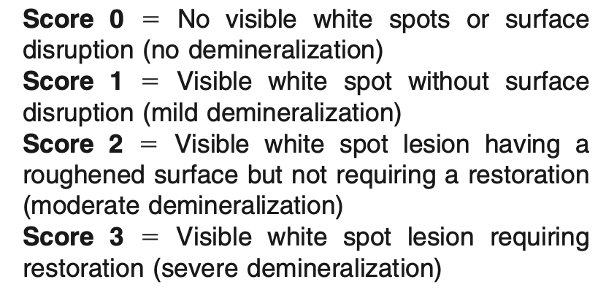
Visual Examination Scale

Slide 9
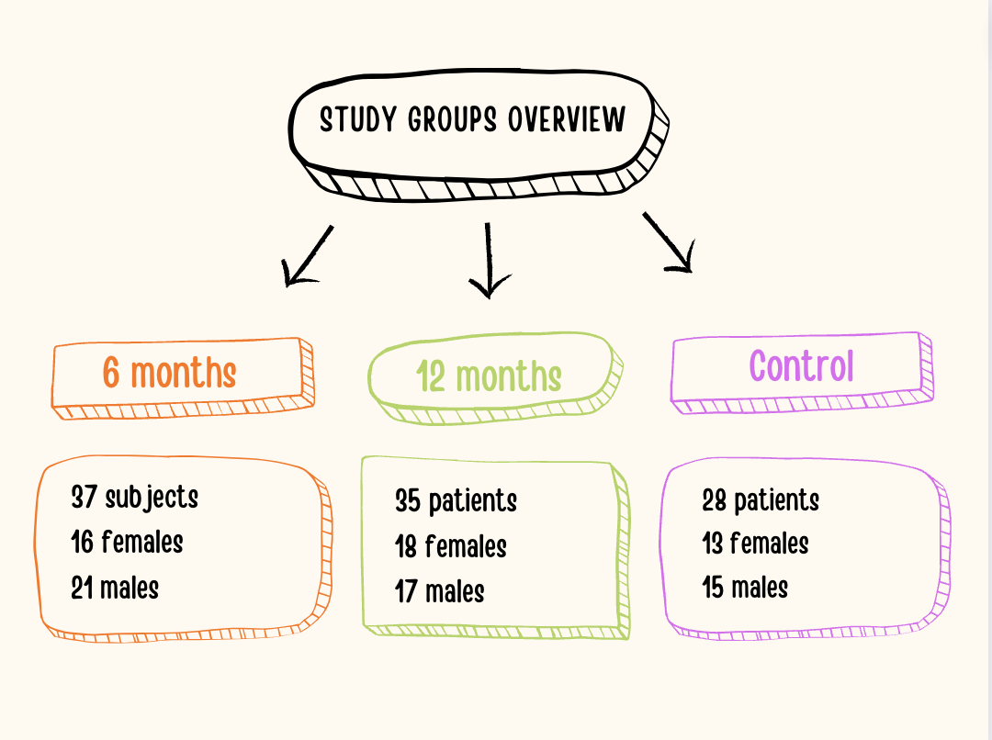

Slide 10
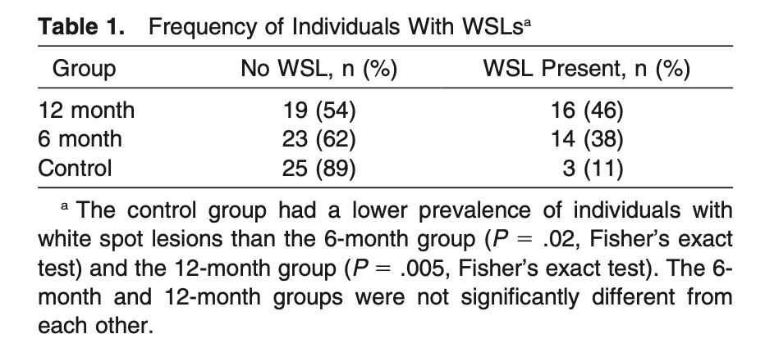
Notes:
Three groups (6-month, 12-month, and control) compared for differences in white spot lesion prevalence using chi-square analysis, followed by Fisher's exact test.
6-month group: 38%
12-month group: 46%
Control group: 11%

Slide 11
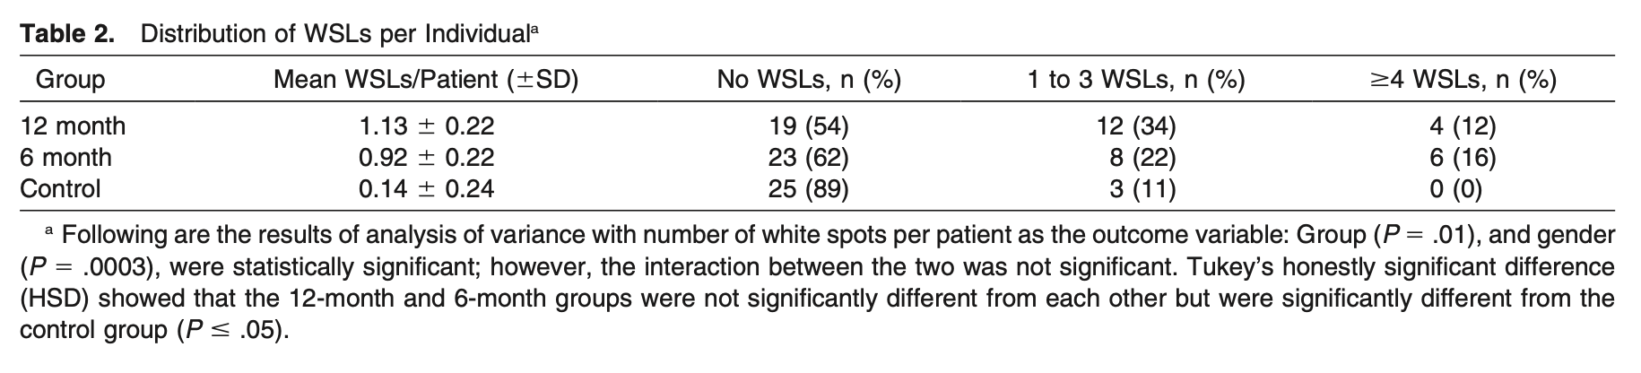
Distribution of WSLs
Notes:
Analysis of variance employed to analyze differences in the mean number of white spots between groups.
6-month group: 62% had no WSLs, 22% had 1-3 WSLs, 16% had ≥4 WSLs.
12-month group: 54% had no WSLs, 34% had 1-3 WSLs, 12% had ≥4 WSLs.
Individual variability noted, with some showing no demineralization and others having WSLs on almost every tooth.
Control group: Almost 90% had no WSLs on bonding day, remaining 10% had 1-3 WSLs.

Slide 12
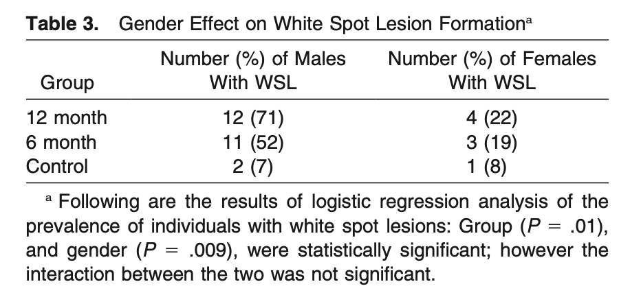
Notes:
Significant difference (P = 0.009) between males and females.
6-month group: 52% of males vs. 19% of females had at least one WSL.
12-month group: 71% of males vs. 22% of females had at least one WSL.
Overall, 76% of subjects with at least one WSL were males, and 24% were females.

Slide 13
Tooth Type Analysis
Logistic regression utilized to evaluate the prevalence of white spots by tooth type.
No Significant Differences in WSL Distribution Among Tooth Types
Maxillary central incisors, lateral incisors, and canines are equally subjected to demineralization.

Slide 14
Logistic Regression Analysis
Confirmation of the significance of group (P = 0.01) and gender (P = 0.009).
No significant interaction between group and gender.
Notes:
Logistic Regression helps us understand the relationship between like time in therapy, gender and the probability of the occurrence of of WSLs

Slide 15
Discussion
WSLs remain a considerable problem during orthodontic treatment due to plaque accumulation around fixed appliances.
38% of subjects had a visual WSL at 6 months, increasing to 46% at 12 months, compared to 11% in the control group.
Conflicting reports on WSL distribution in the literature; this study found no significant differences among teeth.

Slide 16
Discussion
Early detection of WSLs challenging; thorough examination and customized oral hygiene regimens recommended.
Laser gingivectomy suggested to create cleansable tooth surfaces and reduce inflammation.
High prevalence of WSLs at 6 months highlights the quick onset of demineralization with poor oral hygiene.
Significant gender difference observed, with 76% of subjects with WSLs being males; potential explanation is greater compliance among female orthodontic patients.

Slide 17

REFERENCE ARTICLE - 1982
Treated teeth, whether banded or bonded, showed significantly more white spot formation than the control group.
Labiogingival area of maxillary lateral incisors exhibited the highest incidence.
Maxillary incisors had the highest incidence among tooth segments.
Lowest incidence observed in the maxillary posterior segment.
No white spots found on the lingual surfaces of mandibular canines and incisors with a bonded retainer.

Slide 18
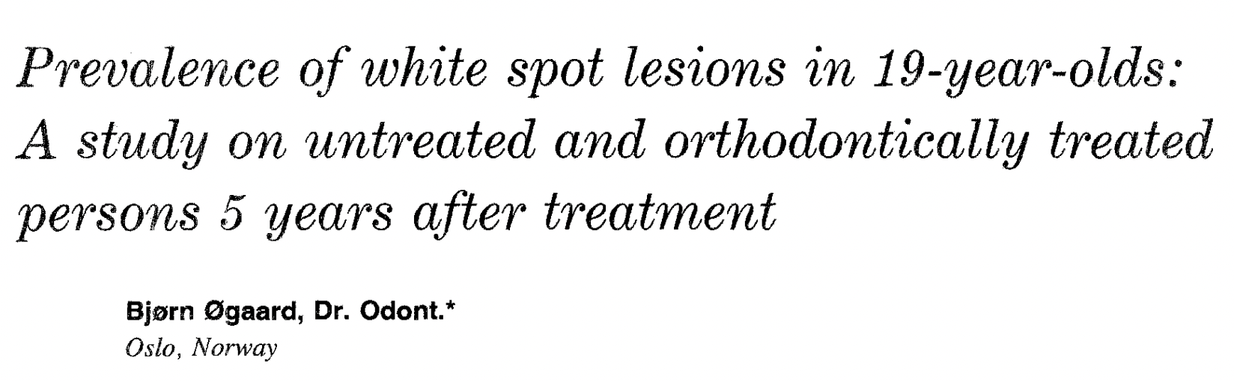
REFERENCE ARTICLE- 1982
Assess the prevalence of white spot lesions in 19-year-olds who underwent orthodontic treatment compared to untreated subjects.
Highest prevalence on first molars in both groups.
White spot lesions post-orthodontic treatment with fixed appliances can persist as an esthetic concern, even more than 5 years after treatment.

Slide 19

CROSS REFERENCE - 2014
Participants: 84 patients (45 females, 39 males), aged 13-18 years
Gorelick index used to evaluate WSLs on the buccal surface before (T1) and after (T2) treatment.
Highest in mandibular first molars (20.6%), followed by maxillary lateral incisors (16.3%) and mandibular second premolars (13.7%).
Patients undergoing orthodontic treatment longer than 30 months are at a higher risk of white spot formation and increased DMFT index.

Slide 20

CROSS REFERENCE - 2019
Design: Prospective observational study.
Duration: January 2016 to December 2017 (two years).
Data Collection: Routine clinical photographs taken at 6 and 12 months to examine white spot lesions (WSLs).
Out of 36 cases with WSLs, 14 (38.9%) were male, and 22 (61.1%) were female.
21.8% of study subjects developed WSLs during orthodontic procedures.
Incisors were the most commonly affected teeth.

Slide 21

Notes:
Treatment protocols for WSLs
• First, allow natural remineralization.
• Low doses of F applications (50 - ppm F. mouth rinses).
•Use of CPP-ACP - Casein phosphopeptide-amorphous calcium phosphate
• If the lesions persist, professional bleaching is indicated.
• If the effect of bleaching is inadequate, Microabrasion is an option.
• Lastly, direct or indirect Veneers could be considered.

