Slide 1
































- Poojitha Surgi

Slide 2
REMINERALIZATION vs DEMINERALIZATION
- The constant ‘tug of war’
Demineralization and remineralization is a continuous process;
A disruption in the balance of these two processes could be detrimental to the tooth repair.
The ratio between the two processes is important in determining hardness and strength of tooth structure.

Slide 3







DEMINERALIZATION: is the process of removing minerals in the form of mineral ions from dental tissues. ( loss of hydroxyapatite crystals )
Etiology: Caries
Bleaching
Acid etching
Erosion
Usage of acidic cements
REMINERALIZATION: is defined as the process whereby calcium and phosphate ions are supplied from a source external to the tooth to promote ion deposition into crystal voids in demineralized enamel to produce net mineral gain

Slide 4
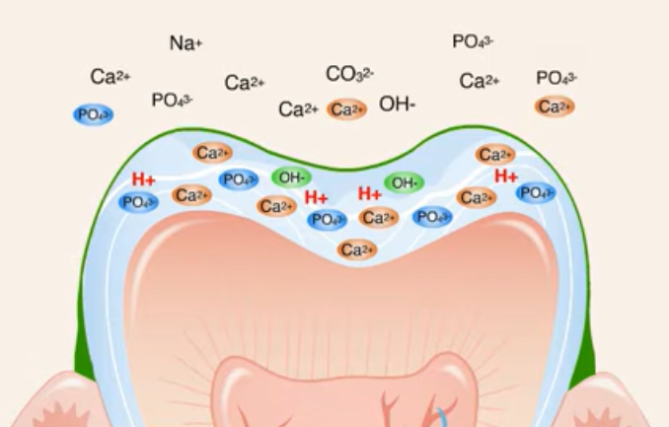
MECHANISM OF DEMINERALIZATION
The mineral component of enamel, dentine, and cementum is hydroxy­apatite (HA) = Ca₁₀(PO₄)₆ (OH)₂
In a neutral environment, HA is in equilibrium with the local environment (saliva) which is saturated with Ca2+ and (P04)3- ions
Demineralization of Ca, Po4 by organic acids produced by bacteria dwelling in biofilm. Diffusion of acid into the tooth.
HA is reactive to hydrogen ions at or below pH 5.5, H+ reacts preferentially with the phosphate groups immediately adjacent to the enamel crystal surface. The process can be described as conversion of (P04)⁻³ to (HP04)⁻² • The (HP04)⁻² is then not able to contribute to the normal HA equilibrium, and the HA crystal therefore dissolves
White spot lesion due to loss of subsurface enamel-loss of translucency
Presence of acquired pellicle slows the acid diffusion.
Diffusion of acids into the tooth; as enamel is a porous solid.
Carious enamel is more porous.
High pKa (weak acids)- acetate diffuse faster than a stronger acids.
Organic acids in plaque fluids can be dissociated or un dissociated.
i) dissociated form attacks the enamel.
ii) undissociated form acts as reservoir for H+
Enamel lamellae & Prism sheath preferential pathway

Slide 5
DEMINERALIZATION REMINERALIZATION
Is it possible?
At pH >5.5 :- presence of Ca & PO₄ ; demineralization can be reverted to remineralization.
When it occurs,
#1 Before cavitation : shows evidence of carious episode by the presence of discoloration due to incorporation of exogenous pigments.
#2 After cavitation : the remainder substance turns hard & becomes dark brown or black.
Either surface is termed arrested caries. Dentin : EBURNATED DENTIN
Resistant to future caries.

Slide 6
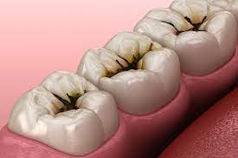
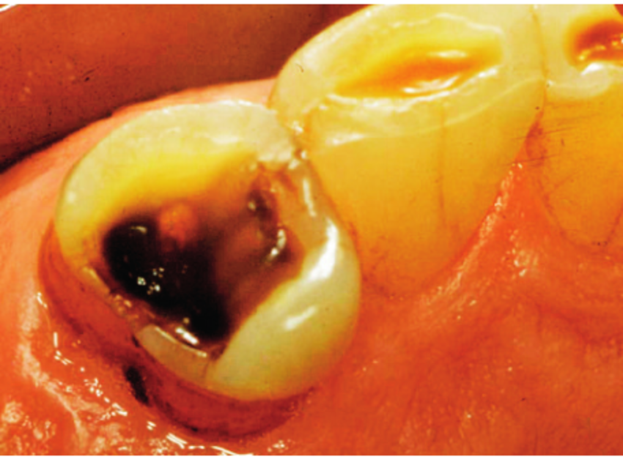
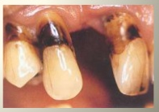
BEFORE CAVITATION
AFTER
CAVITATION

Slide 7
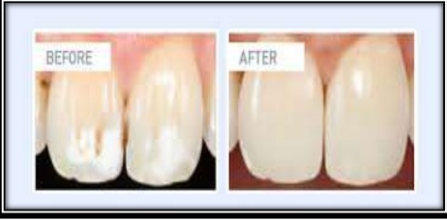
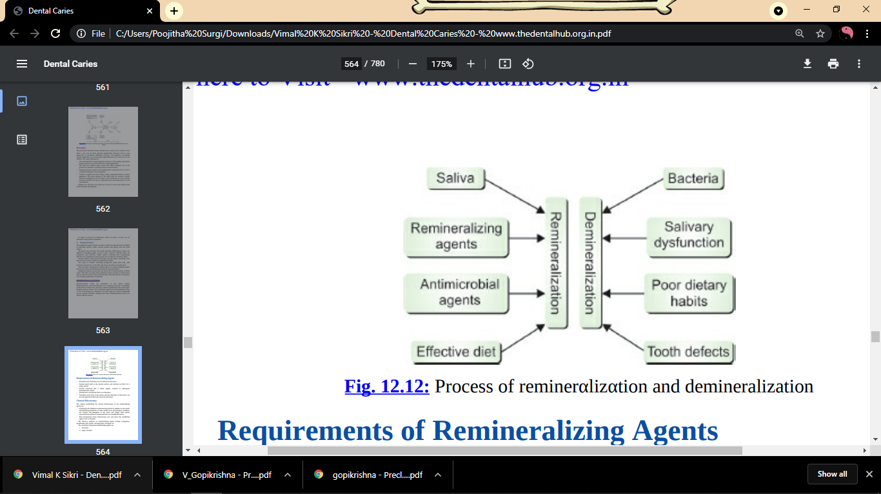
Incipient carious lesions can be naturally repaired by remineralization.
If the lesions are detected at an early stage, the caries development can be avoided.

Slide 8
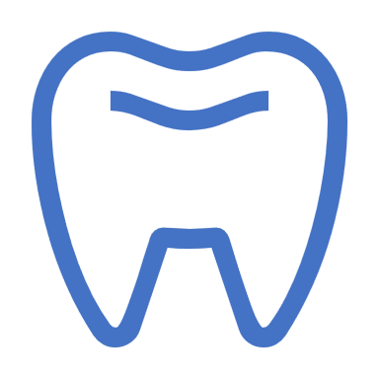
MECHANISM OF REMINERALIZATION
Ca
Supersaturated state – constant opportunity for remineralization – protect teeth in times of cariogenic challenge.
Either the apatite dissolution products can reach neutrality by buffering, or Ca⁺² and (P0₄)⁻³ ions in saliva can inhibit by the process of dissolution through the common ion effect.
Teeth becomes encrusted with mineral deposits.
This enables rebuilding of partly dissolved apatite crystals and is termed remineralization.
Normally, remineralization is a surface phenomenon that is self-limiting and prevents penetration of ions into the depth of the lesion, especially in the presence of fluoride.
Rapid deposition of fluorapatite will form a firm surface layer, which is notably more resistant to further demineralization but at the same time is resistant to penetration of the calcium and phosphate ions required to rebuild the lesion in depth.
The result is often the visible persistence of the white spot.
PO₄
PO₄
Ca
Ca

Slide 9
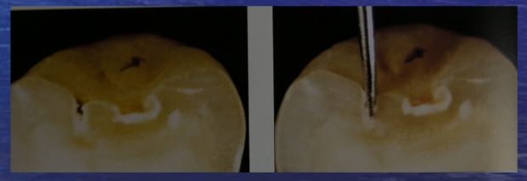

CLINICAL PRESENTATION
Seen as opaque white area/ brown-to-black, hard, appears same whether it’s wet or dry. ( unlike incipient lesion )
Sharp explorer should not be used for tactile detection as it may cause cavitation of an incipient lesion.

Slide 10
FACTORS
DEMINERALIZATION
REMINERALIZATION
Microbial factors; Strep.mutans- acidogenic, aciduric Lactobacilli- development of lesion.
Salivary factors; pH, flow rate, buffer capacity. Demineralization occurs in areas of high exposure to fermentable sugars with diminished salivary effects. Flow rate; promotes cleansing action, buffering capacity, antibacterial activity & clearance of substrates. pH & buffering; counter acid produced. Chief system carbonic acid bicarbonate.
Salivary pellicle; layer of adsorbed salivary proteins on solid surfaces exposed to oral environment. Function; provision of matrix for remineralization, lubrication of teeth, protection of enamel against demineralization, modulation of microbial flora. Basal layers of pellicle seems to be important regarding its protective function.
Environmental factors; Oral hygiene, diet, tooth; accumulation of plaque encourage growth of aciduric bacteria. Diet; frequency of CHO consumption. Overlapping episodes of acid challenge.
Tooth; location, morphology, composition, ultra structure, post eruptive age. Inorganic factors- crystal size, shape & proximity of crystals. Carbonate decreases solubility of crystals.
Saliva & plaque fluid – supersaturated with Ca, PO₄
Statherin, a proline-rich peptide, and casein found in milk stabilize and prevent excess deposition of these ions.
Fluorine, in fluorapatite prevents further penetration of calcium and phosphate ions into the deep structures of tooth.
Increased salivary flow – increased chances of remineralization..
At critical ph ( 5.5 )
Oral hygeine

Slide 11
REMINERALIZING AGENTS
FLUORIDE : increases caries resistance, rate of maturation, surface energy, remineralization of incipient lesions, interference with microorganisms & Improved tooth morphology
Personal applications (eg, dentifrices, rinses) & Professional applications (eg, varnishes, foams, gels, fluoride releasing restorative materials).
Fluoride levels of about 3 parts per million (ppm) in the enamel are required to shift the balance from net demineralization to net remineralization
Newer Technologies for Enamel Remineralizing Systems:
Crystalline Calcium Phosphate Remineralizing Systems: Problem :poor solubility of the calcium phosphate phases,
Unstabilized Amorphous Calcium Phosphate Systems
Stabilized Amorphous Calcium Phosphate Systems: A biomimetic remineralization system.
Casein phosphopeptide amorphous calcium phosphate Technology (CPP-ACP): {Recaldent – ( chewing gum ), GC TOOTH MOUSSE – (Dentifrice) }
EnamelonTM technology
NovaMinTM technology
Clinpro Tooth CrèmeTM
Anticay
Hydroxyapatite Carbonate

Slide 12
DISPENSING METHODS
Dentifrices: One of the most practical methods for delivering remineralizing agents.( CPP- ACP )
Pit and fissure sealant: Glass- ionomer sealants release fluoride. The addition of fluorides and CCP- ACP can further enhance remineralization.
Pastes Rinses: Pastes contain calcium- and phosphate realeasing components (eg, CCP-ACP) with or without fluoride.
Chewing gums: Numerous studies have demonstrated the caries-preventing qualities of frequent use of chewing gum sweetened by dietary sugar alcohols such as xylitol and sorbitol (or) sugar-free gum
Restorative materials: Glass Ionomers, Compomers, Giomers
Glass ionomers: Salivary fluoride concentration is found to remain elevated for up to 1 year after placement of GIC restorations.
Compomers: Release fluoride by a mechanism similar to that of glass and hybrid ionomers but the amount of fluoride release and its duration are less than those of glass and hybrid ionomers.
Giomers: While giomer released fluoride, it did not have an initial “burst” type of release like glass ionomers. Their long- term release of fluoride is lower than that of the other materials.

Slide 13










Thank You

